Slide 1
AWS Data Analytics Products
Group 7
Matthew Esporrin
Brittany Hayes
Verghese Polakunnil
Lisha Shangguan

Slide 2
Agenda
1
AWS Analytics Overview
Amazon EMR
Amazon QuickSight
Amazon Kinesis
CloudSearch

Slide 3
Amazon Analytics Overview
2

Slide 4
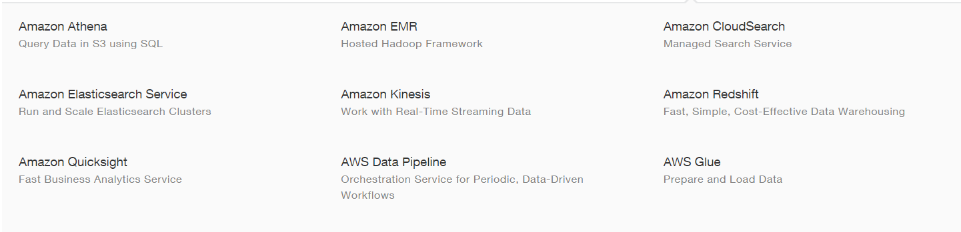
AWS Analytics
3

Slide 5
AWS Analytics
4

Slide 6
Amazon EMR
5

Slide 7
What is Amazon Elastic MapReduce (EMR)?
6
Provides a managed Hadoop framework
Quickly & cost-effectively process vast amounts of data
Run other popular distributed frameworks such as Spark
Notes:
What is Amazon Elastic MapReduce? Or what is Amazon EMR? It provides a managed Hadoop framework that makes it easy, fast, and cost-effective to process vast amounts of data in the AWS cloud using parallel distributed execution of data processing tasks. With EMR, you can use a wide variety of other distributed frameworks that exist within what’s generally known as Hadoop ecosystem and we are going to cover some of those later today. What their usage cases are and how you can access these other distributed frameworks within the ecosystem through Amazon’s EMR service.

Slide 8





Why Amazon EMR?
7
Easy to Use
Low cost
Elastic
Launch a cluster in minutes
Pay an hourly rate
Easily add or remove capacity
Reliable
Secure
Flexible
Spend less time monitoring
Manage firewalls
Control the cluster
Notes:
EMR is easy to use. When you launch a cluster on Amazon EMR, the web service allocates the virtual server instances and configures them with the needed software for you. Within minutes you can have a cluster configured and ready to run your Hadoop application.
It’s low cost. By running your cluster on Amazon EMR, you only pay for the computational resources you use. You do not pay ongoing overhead costs for hardware maintenance and upgrades and you do not have to pre-purchase extra capacity to meet peak needs.
It’s elastic so you can provision one hundreds or thousands of compute instances and process data on any scale.
It’s reliable. Hadoop installed on Amazon EMR clusters is integrated with Amazon S3.
You can encrypt data inside EMR using s3 server-side encryption or client-side encryption.
Finally, you have complete control of your cluster you access to every instance you can easily install additional applications. You can customize your cluster in a huge variety of different ways.

Slide 9
Example Use Cases
8
Clickstream Analysis
Amazon EMR can be used to analyze click stream data in order to segment users and understand user preferences.
Advertisers can also analyze click streams and advertising impression logs to deliver more effective ads.
Notes:
Amazon EMR can be used to build a variety of applications such as recommendation engines, data analysis, log processing, clickstream analysis, ETL, fraud detection, genomics, financial analysis or data correlation in various industries. This time we will talk about three examples of usage that customers put this service to.
By using clickstream analysis, we can segment users into different groups and understand their behaviors with respect to advertisements or application usage. Ad networks or advertisers can perform clickstream analysis on ad-impression logs to deliver more effective campaigns or advertisements to end users. Reports generated from this analysis include various metrics such as source traffic distribution, purchase funnel, lead source ROI, and abandoned carts among others.

Slide 10
Example Use Cases
9
Web Log Processing
Amazon EMR can be used to process logs generated by web and mobile applications.
Amazon EMR helps customers turn petabytes of un-structured or semi-structured data into useful insights about their applications or users.
Notes:
We can use EMR to process logs to understand the usage of content such as video, file downloads, top web URLs accessed by end users, user consumption from different parts of the world, and many more. We can process any web or mobile application logs using EMR to understand specific business insights relevant for the business. We can move all our web access application or mobile logs to Amazon S3 for analysis using EMR even if we are not using AWS for running our production applications.

Slide 11
Amazon QuickSight
10

Slide 12

Amazon QuickSight Overview
11
AWS BI tool to easily and quickly gain business insight from data
Easily create visualizations
Do ad-hoc analysis
Gain insight from large data sets quickly with SPICE
Notes:
Amazon QuickSight is a business intelligence tool designed for fast analysis on very large data. QuickSight facilitates the creation of visuals with a simple UI, allowing anyone to easily create visualizations and share them with others in their organization. It has powerful data processing power in SPICE, which will be discussed later. Overall, this is a helpful tool for anyone using large data sets, especially for managers or those less experienced in analytics.

Slide 13

Database Connectivity
12
QuickSight connects to a variety of data sources:
CSV or excel files
Redshift
RDS
Aurora
Athena
SQL Server, MySQL and PostgreSQL
In the near future QuickSight will also connect to EMR, DynamoDB and Kinesis
Notes:
QuickSight is able to draw data from a variety of sources, including CSV or excel files, MySQL, and SQL Server. It can also connect to various AWS data storage services including Redshift, RDS, Aurora and Athena. QuickSight documentation seems to promise future compatibility with even more data sources such as EMR and Kinesis.

Slide 14
Using Data in QuickSight
13
Pull your desired data into a data set within QuickSight with no need to re-prepare the data for each analysis you do
QuickSight allows some data manipulation of data sets:
Rename fields
Change data types
Create calculated fields
Apply filters
Join tables
Notes:
Data is imported into QuickSight as a data set, and once your data set is created, there is no need to re-prepare the data for future analyses. Some data manipulation is available in this tool, such as filtering, joining, or renaming data. Also, within your data set you can change data types and create calculated fields. All of these features allow the user to manipulate the data to gain insight without altering the structure of the original data they pulled in. The filtering tool is especially useful in creating visualizations for specific areas, for example: looking only at sales made in December.

Slide 15
Visualization
14
Use a simple UI to create charts and dashboards
Create bar charts, line graphs, area charts, scatter plots, heat maps, pie graphs, tree maps and pivot tables
Gain quick insights from charts
Auto Graph
Built-in suggestion engine to recommend visualizations based on your data
The algorithm learns which charts best match your needs and preferences
Offers choices of the most appropriate graph types
Visualizations are accessible from any browser or compatible mobile device
Notes:
The simple UI is easy to learn, and QuickSight offers some helpful tutorial videos and example data to help you get started as well. The interface mostly involves selecting which features in the data you want to look at or dragging and dropping features into the Field Wells bar. Several common chart types are available, such as bar charts, line graphs, scatter plots, and pivot tables. One of the most interesting features of QuickSight is Auto Graph. Auto Graph is a built-in suggestion engine that automatically creates visualizations from your selected data features, offering recommended chart types. Visualizations made in QuickSight are accessible from any browser or compatible mobile devices.

Slide 16
Stories
15
Share analyses with interactive stories
Combine your visualizations into dashboards
Secure sharing with coworkers
Notes:
A story in QuickSight is a simple format to share interactive analyses within your organization. You can combine your visualizations into dashboards and put your dashboards into stories and securely share them with coworkers or clients.

Slide 17
SPICE
16
Super-fast, Parallel, In-memory, Calculation Engine
Works in the cloud for fast data processing
Uses columnar storage, in-memory technologies, machine code generation, and data compression to allow rapid responses to interactive queries on large datasets
Automatically replicates data
Many users can perform analysis simultaneously across data sources
Notes:
SPICE is the real power behind QuickSight. SPICE stands for Super-fast Parallel In-memory Calculation Engine. Running in the cloud, SPICE can process huge amounts of data very quickly and automatically replicates your data to create a data set for QuickSight. This computational power allows many users to perform analyses simultaneously across shared data sources. Each user has access to the pooled SPICE capacity for their group, and each additional paid user increases the SPICE capacity by 10GB. Additional SPICE capacity can be purchased as necessary and data sets can be deleted to free up extra capacity.

Slide 18
Pricing
17
Annual pricing with the option of monthly
Price is calculated per user per month
Affordable cost with no maintenance fees, infrastructure management, or hardware purchases
Notes:
One of the most appealing aspects of QuickSight is its pricing. The cost is very affordable, with no maintenance fees or hardware to purchase. Also, it is free to try for the first user in a group. Signing up does require an AWS account, which also offers a free trial period.

Slide 19
Future Capabilities
18
Amazon plans to allow integration of QuickSight with the following BI tools:
Tableau
TIBCO
Domo
Qlik
In the near future Android devices will be able to access QuickSight
Notes:
Some of the possible future features of QuickSight include integration with other non-AWS BI tools such as Tableau and access on Android devices. If Tableau were integrated, QuickSight could quickly process your data and Tableau could be used to create detailed and customizable visualizations. In conclusion, QuickSight is very useful if you want to quickly produce simple visualizations from large data sets.

Slide 20
Amazon Kinesis
19

Slide 21
What is Kinesis?
20
A platform to load and analyze streaming data on AWS
Developed to handle data collected from IoT
3 Components
Firehose
Analytics
Streams

Slide 22
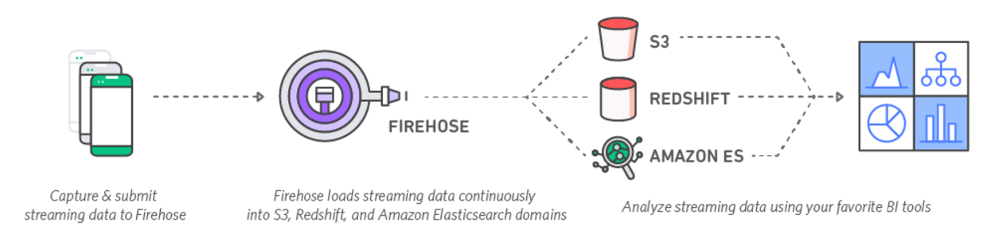
Kinesis Firehose
21
Data is continually streamed from devices into an AWS DB solution

Slide 23
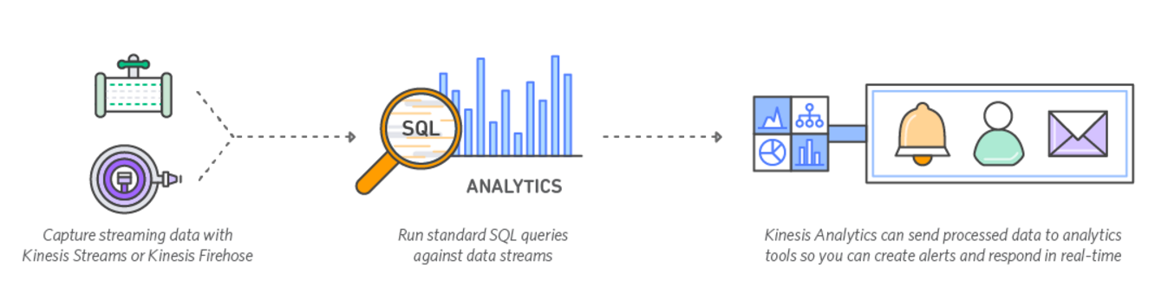
Kinesis Analytics
22
Allows data to be analyzed using pre-built tools

Slide 24
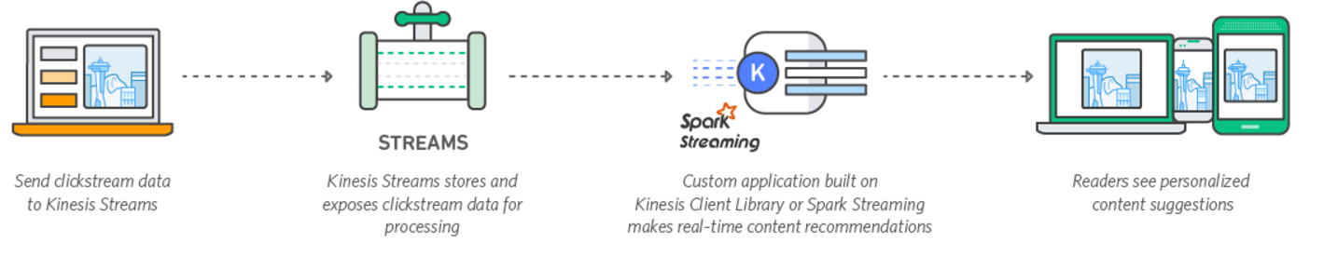
Kinesis Streams
23
Build your own apps to analyze, display and distribute data

Slide 25


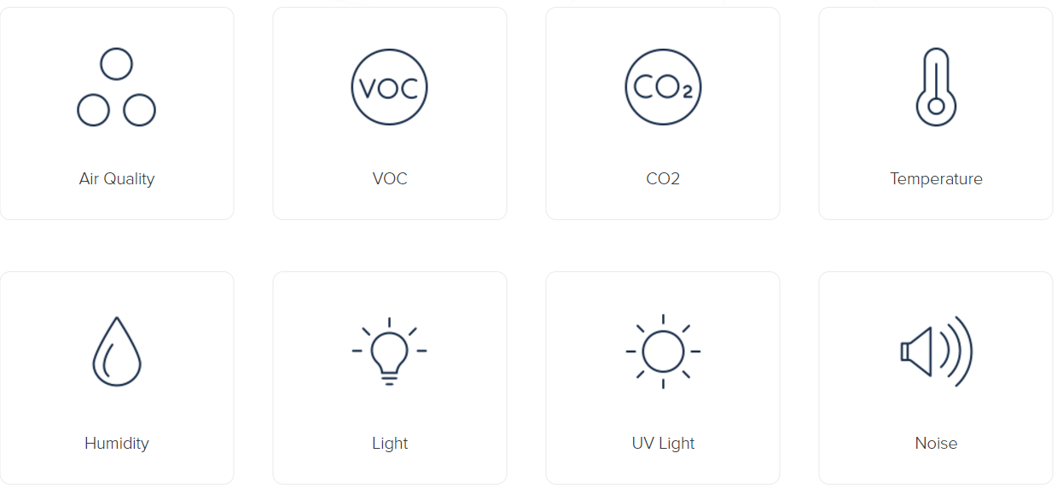
Kinesis in Practice:
24

Slide 26
Amazon CloudSearch
25

Slide 27
What is Amazon CloudSearch?
26
Available in:
US East (Northern Virgina), US West (Oregon), US West (N. California)
Ireland, Frankfurt, South America (Sao Paulo)
Asia Pacific (Singapore, Tokyo, Sydney, and Seoul)
Cloud based Search Solution” service offered by Amazon AWS
Created for mobile and web app developers, web designers and businesses
Makes it possible to search large collections of data to quickly find the best results

Slide 28
Advantages of Amazon CloudSearch
27
Lets customers add search capability without needing to manage hosts, traffic and data scaling, redundancy, or software packages.
Customers do not need to maintain, operate, configure and update search software or servers.
Does not have to worry about scaling search environment as business grows
Low hourly rates only for the resources consumed
Amazon CloudSearch can offer significantly lower total cost of ownership compared to operating and managing your own search environment.

Slide 29
More Info
28
Data may be stored on Amazon S3, or records in an Amazon DynamoDB or Amazon RDS
To optimize costs across AWS services store in:
Amazon S3 - large objects or infrequently accessed data sets should be stored in Amazon S3
DynamoDB - smaller data elements or file pointers (possibly to Amazon S3 objects)

Slide 30
Using CloudSearch
29
Create Search Domain
Upload Data for indexing
SEARCH!

Slide 31
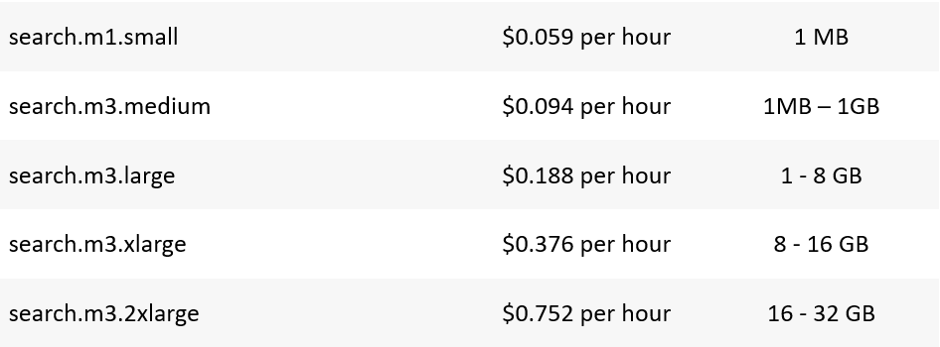
Pricing
30

Slide 32
References
31
https://aws.amazon.com/emr/
https://www.slideshare.net/AmazonWebServices/amazon-emr-masterclass
http://docs.aws.amazon.com/quicksight/latest/user/editions.html http://docs.aws.amazon.com/quicksight/latest/user/managing-spice-capacity.html
http://docs.aws.amazon.com/quicksight/latest/user/welcome.html’
http://docs.aws.amazon.com/cloudsearch/latest/developerguide/getting-started.html
https://aws.amazon.com/kinesis/

